Slide 1
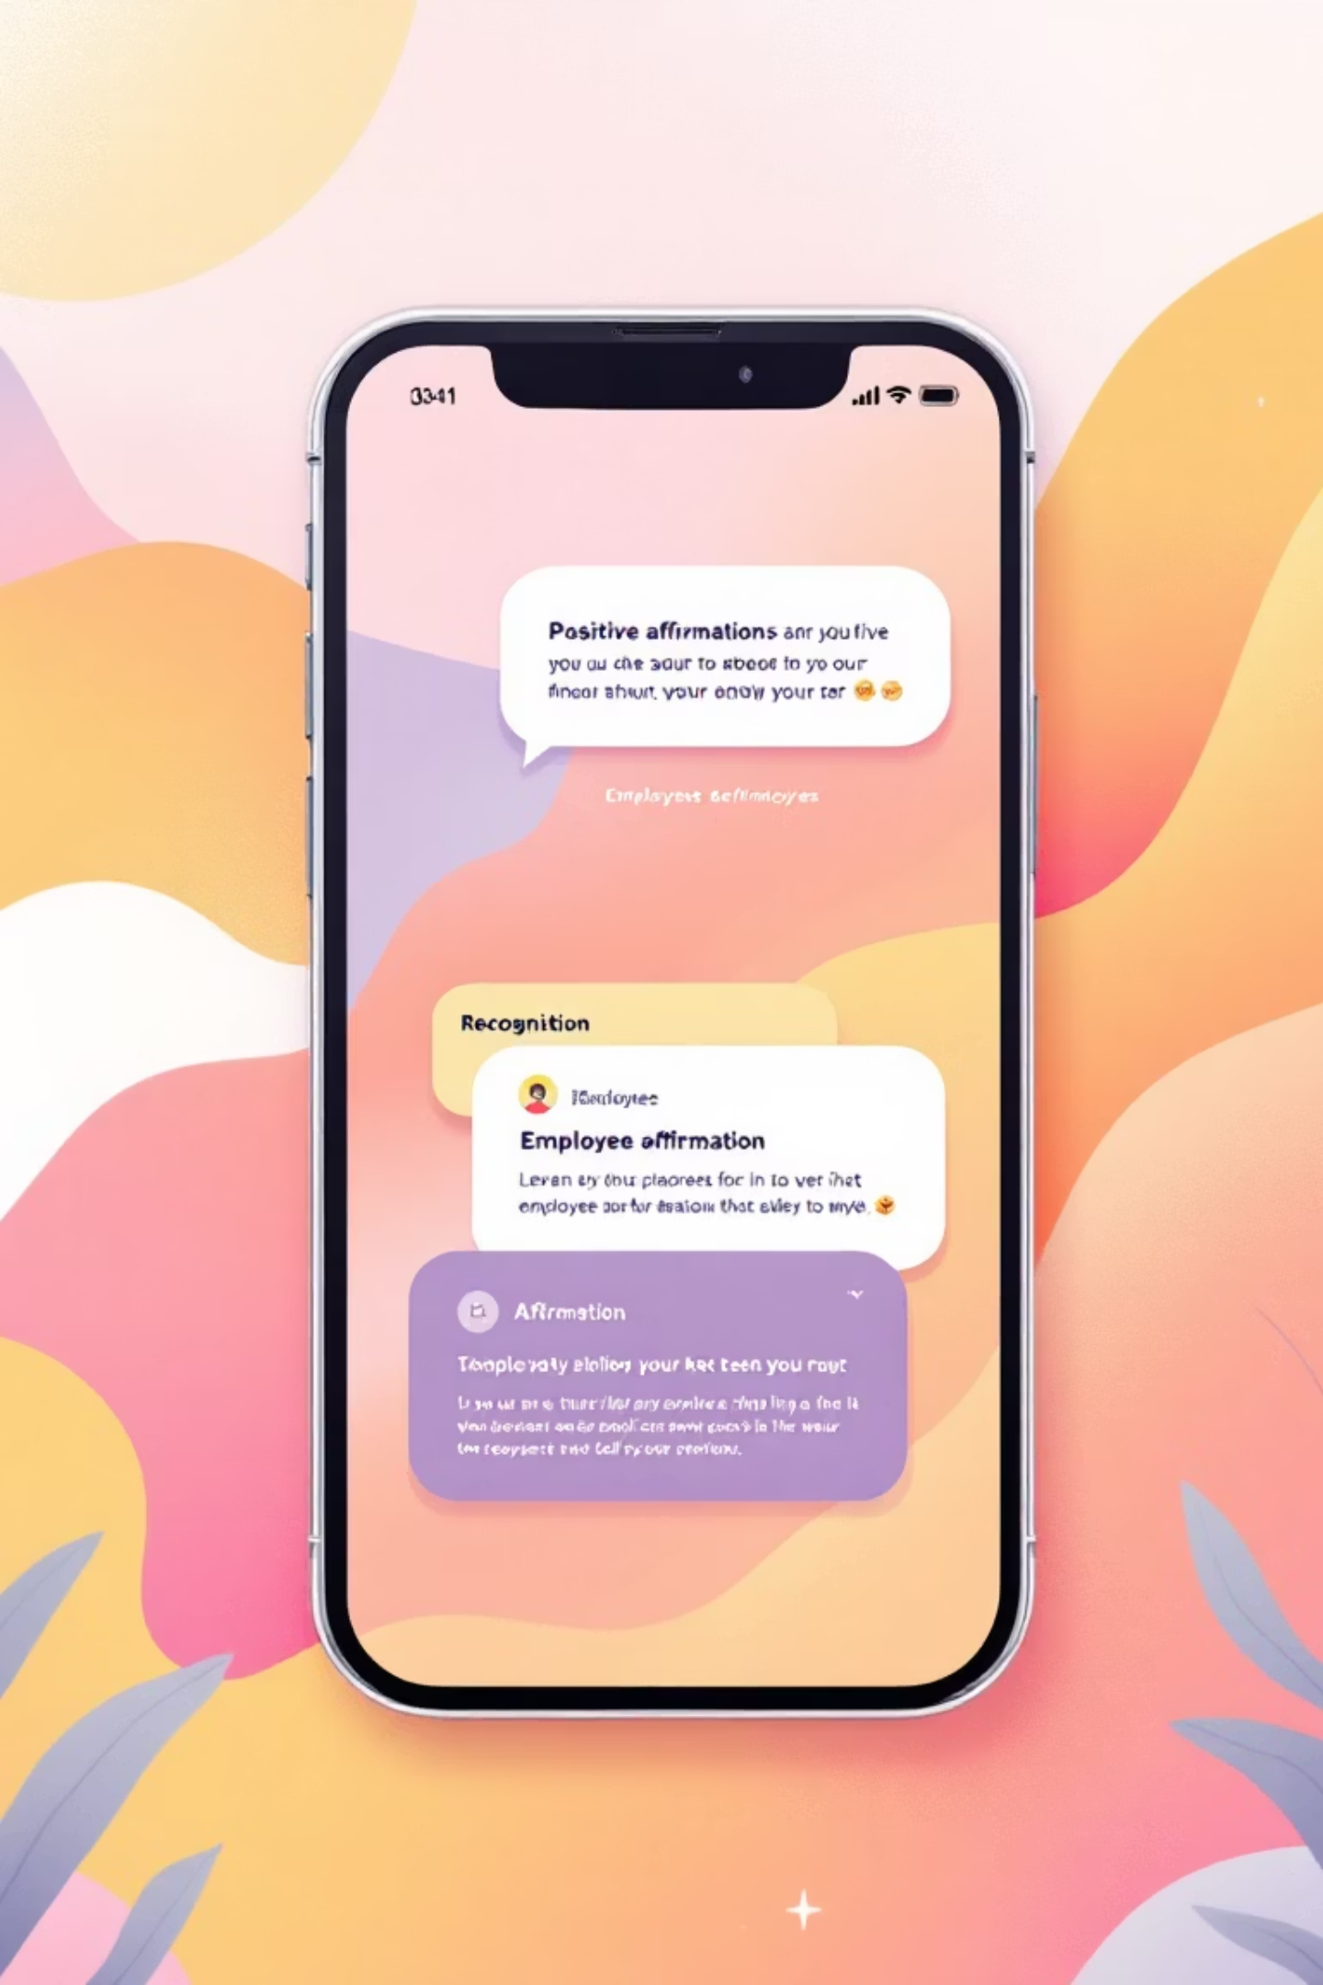

Kudosphere: Celebrating Workplace Achievements Digitally
Welcome to the Kudosphere—a dynamic digital platform meticulously designed to transform how organizations recognize and celebrate the daily achievements and major milestones of their employees.
Transforming Recognition
We revolutionize how organizations recognize and celebrate employee milestones and daily wins, moving beyond annual reviews.
Fostering Appreciation
Kudosphere acts as a dynamic platform fostering a visible, thriving culture of appreciation and deep employee engagement.

Slide 2

The Power of Recognition in Today’s Workplace
In the current hybrid and remote work landscape, genuine recognition is more critical than ever. It acts as the glue that maintains team cohesion and commitment.
Retention Multiplier
Employees who receive regular, meaningful recognition are 4x more likely to stay long-term, significantly reducing turnover costs (State of Recognition Report, 2025).
Boosting Performance
Consistent appreciation directly boosts morale, leading to higher individual productivity, better teamwork, and increased overall organizational efficiency.
Despite its known benefits, research shows that 82% of employees globally still feel underappreciated, creating a significant engagement gap that Kudosphere is specifically designed to close.

Slide 3




Kudosphere’s Core Features: Seamless Appreciation
Peer Recognition
Milestone Celebrations
Empower employees to give and receive real-time 'kudos' across the organization, making appreciation a daily, social experience.
Automated, timely celebrations for birthdays, work anniversaries, and major project completions, ensuring no achievement goes unnoticed.
Centralized Analytics
Values Alignment
Managers gain a centralized dashboard with data to track recognition frequency, engagement levels, and overall impact on culture.
Tag recognition posts with company values to reinforce desired culture, behaviors, and strategic objectives visibly.

Slide 4

Built on a Modern, Scalable Tech Stack
Our platform is engineered for speed, reliability, and cross-platform accessibility, ensuring a seamless user experience regardless of device or location. This robust foundation guarantees that your recognition platform scales effortlessly with your organization's growth.
Firebase
Leveraged for real-time database capabilities and secure authentication, ensuring seamless, instant recognition updates and user access.
Flutter
Used to build a unified, high-performance cross-platform mobile and web application, delivering a smooth, intuitive user experience on all devices.
Node.js
Provides a robust, scalable backend environment powering our APIs, integrations, and core platform logic, supporting high volumes of real-time interactions.

Slide 5
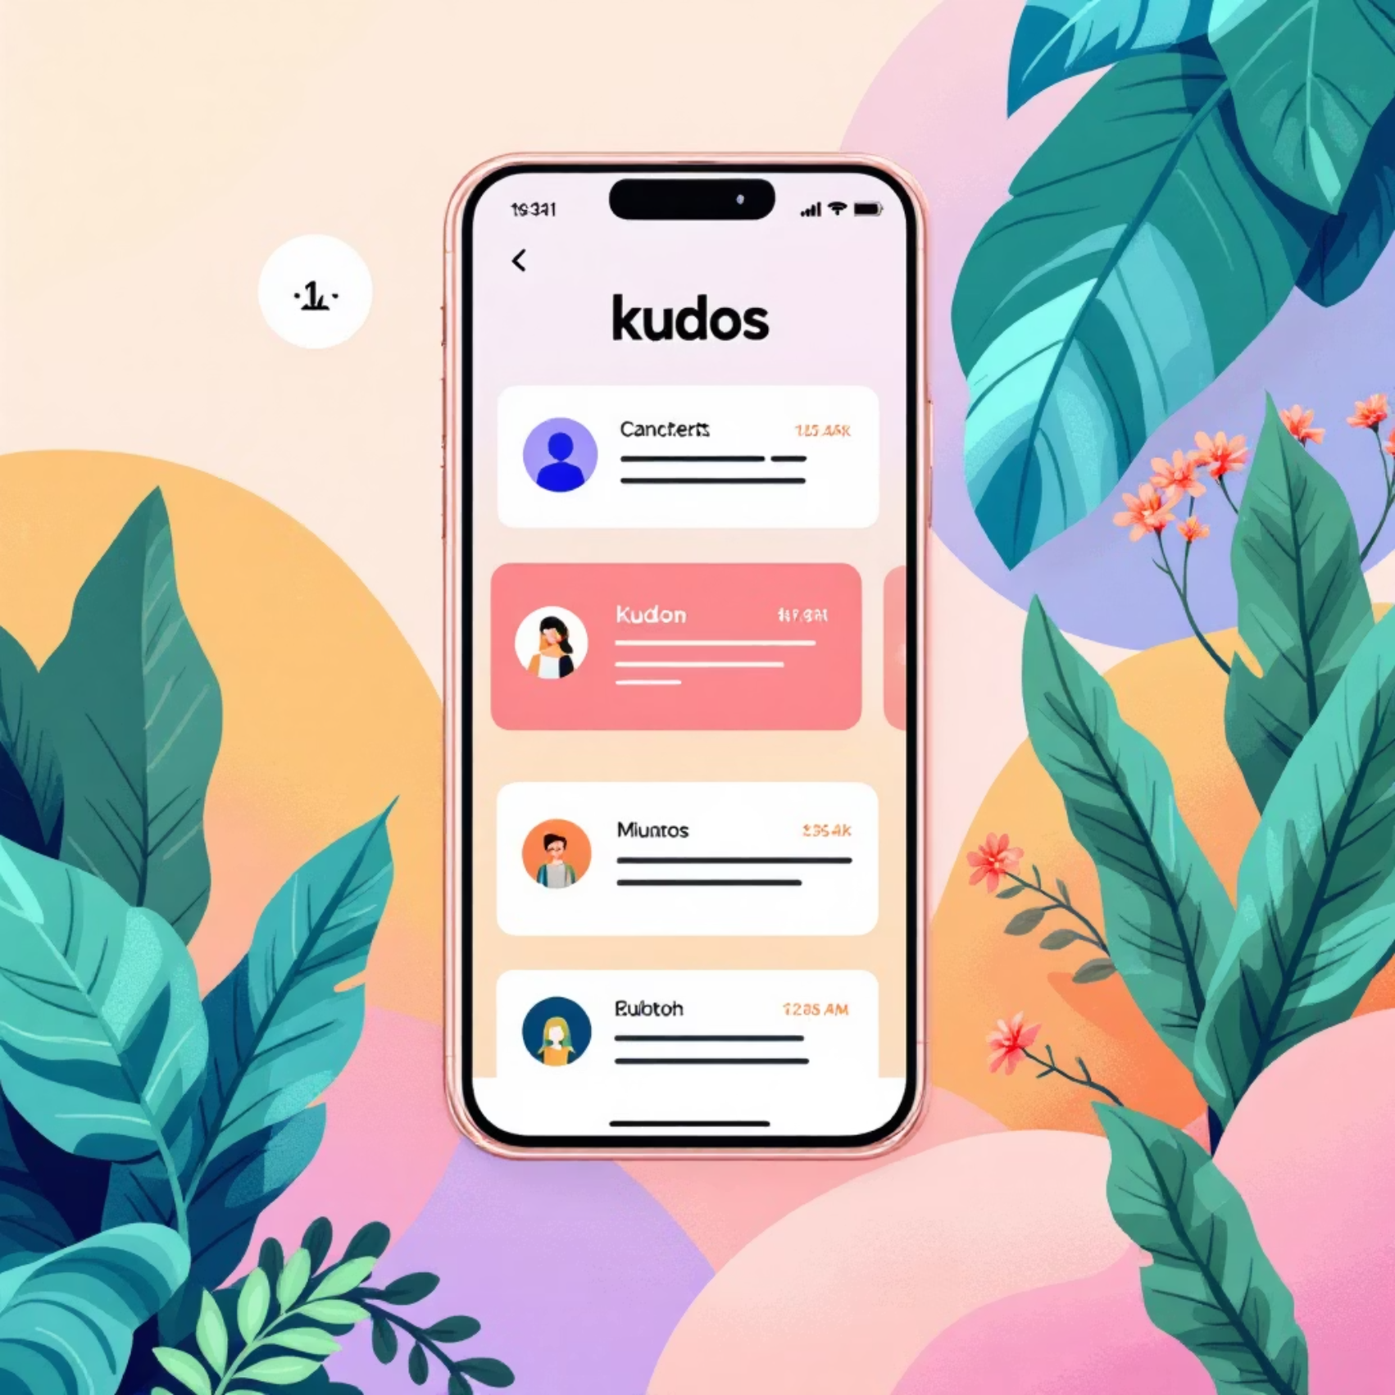
Real Impact: Building Thriving Cultures
Kudosphere transforms culture from the ground up, delivering measurable improvements in how employees feel connected, valued, and motivated.
Increases Loyalty
Drives consistent, meaningful recognition that significantly increases employee satisfaction and long-term loyalty.
Empowers Management
Enables managers to lead with appreciation, improving team cohesion, psychological safety, and overall team performance.
Supports Global Teams
Supports remote and hybrid teams with a mobile-first design, making recognition accessible and inclusive anytime, anywhere across time zones.

Slide 6

Join the Kudospre Movemet
The shift to a truly appreciative workplace starts here. Kudosphere makes appreciation a daily habit and a foundational element of your business strategy.
Empower Your People
Give every employee the voice and platform to celebrate their peers and managers.
Celebrate Every Win
Transform your workplace culture by acknowledging achievements—big and small—consistently and publicly.
Build a Thriving Workforce
Let’s partner to build an engaged, loyal, and high-performing team, one kudos at a time.

